Slide 1
Spring 2021
DATS 501 Fundamentals of Data Science
Cumhur Baştürk
basturkc.academic@gmail.com
Hasan Demirtaş
hasan.demirtas@yeditepe.edu.tr
hdemirtas.academic@gmail.com

Slide 2
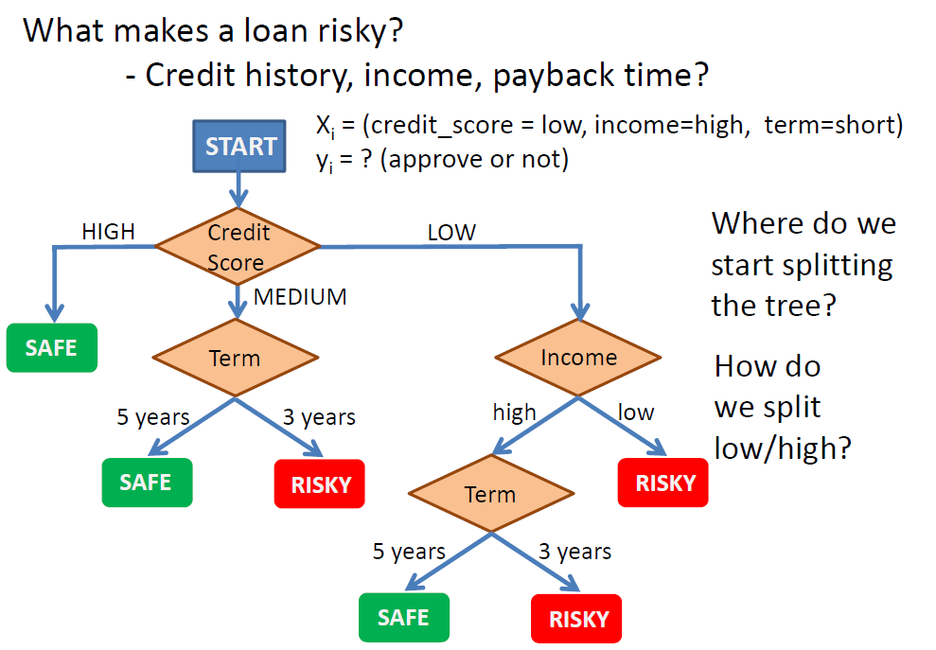
DECISION TREES
Intuition

Slide 3
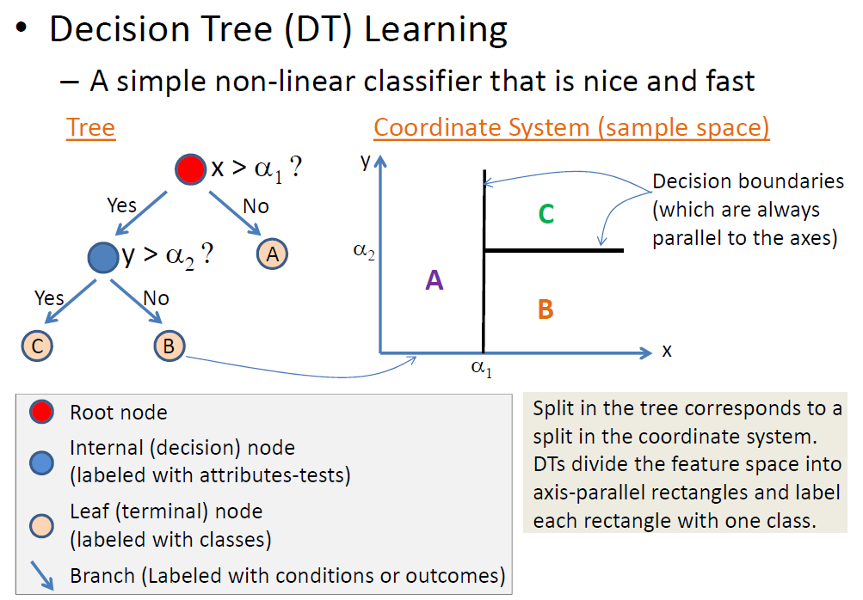
DECISION TREES

Slide 4
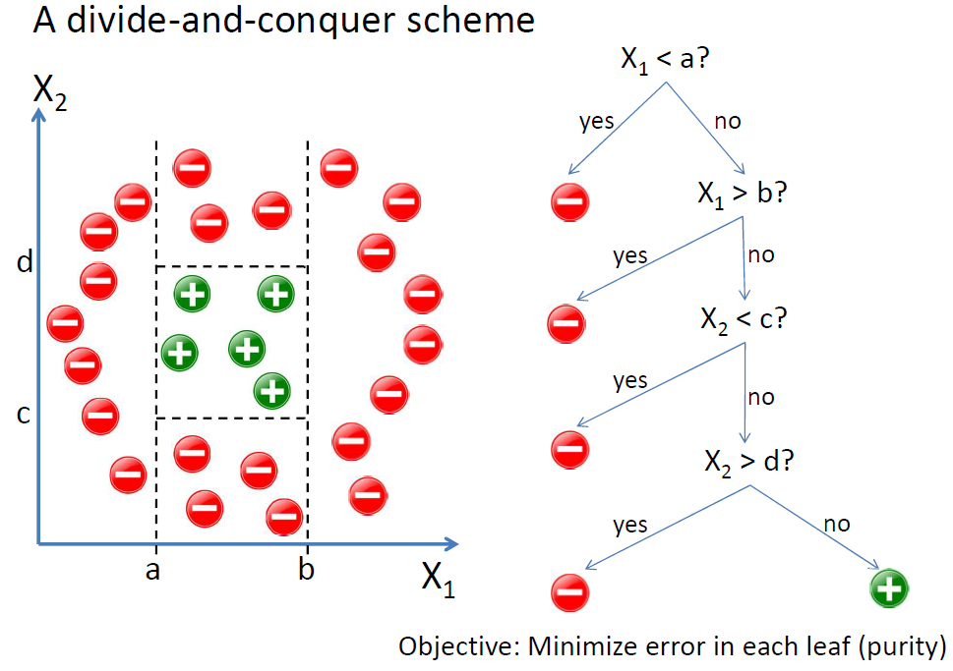
DECISION TREES

Slide 5
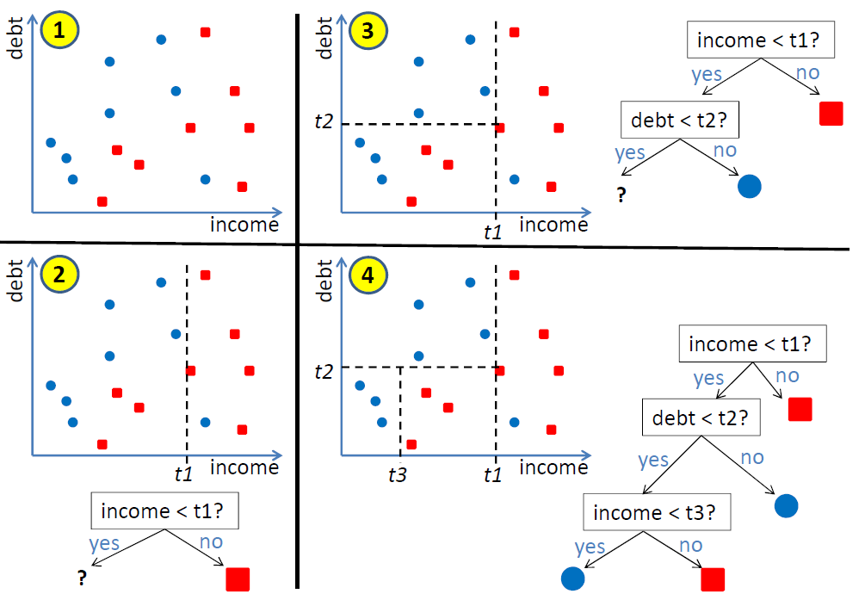
DECISION TREES

Slide 6
DECISION TREES
Characteristics
• Learning method: Supervised learning
• (*)Types of DTs: ID3, C4.5, C5.0, CHAID, CART
• Handling of mixed data types: Yes
• Requires linearly separable data? No
• Classification ability: Binary and Multi-class
• Ability for online classification: Yes
• Interpretability: High (white-box)
• When to consider: Medical diagnosis, text classification, credit risk analysis

Slide 7
DECISION TREES
• ID3
– Simple, created by R. Quinlan (1986)
– Doesn’t handle missing values & susceptible to outliers
– Doesn’t handle numerical features (categorical only)
– Selection criterion: Entropy-based “Information Gain”
• C4.5 (improved ID3)
– Ability to handle numerical and categorical data
– Handles missing data but susceptible to outliers
– Selection criterion: Entropy-based “Information Gain”
• CART (Classification and Regression Trees)
– Creates a binary tree (decision nodes have exactly two branches)
– Handles both categorical & numerical features
– Handles outliers and missing values
– Selection criterion: “Gini index (impurity)”

Slide 8
DECISION TREES
Algorithm (divide-and-conquer)
0. Start at the root (with all training examples)
1. Select an attribute that best separates the classes
2. Split it into subsets (child nodes)
– If the attribute value is categorical:
=> select category(ies)
– If the attribute is numerical:
=> select a threshold
3. Are they pure (all samples from the same class)?
– If yes: stop (training set is perfectly classified)
– If no: select an attribute and split further, go to (3)
Classification: When you have a new data point, start at the root and traverse down the tree to get to the subset this new data point belongs to.

Slide 9
DECISION TREES
Questions
– Which feature to start with at the root (optimization on the attribute to pick)?
• e.g. [income] or [debt]
– Where to split the attribute from (break point for continuous attributes)?
• income > xx?, debt > xx?
– Sequence of other attributes down the tree
– When to stop branching further?

Slide 10
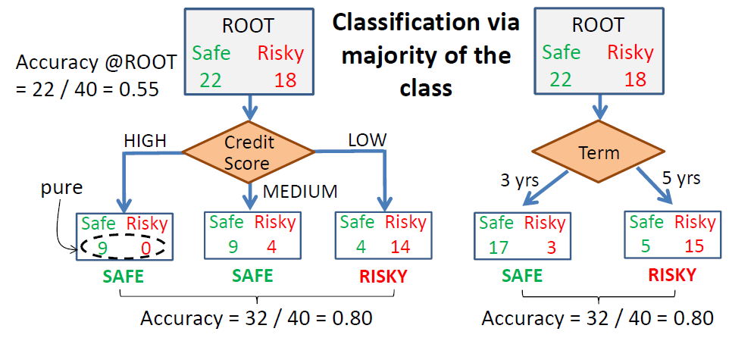
DECISION TREES
Which attribute first?
• What if we want to start with "income" which is a numerical attribute? What would the splitting point be down the tree?
• We need some sort of a measure (purity) to decide which attribute to start splitting with.

Slide 11
DECISION TREES
How to split a numerical attribute?
– Use something that makes sense for the Nature of the problem (or the business)
– Choose a random value
– A common and simple one to use is the mean
– Split according to a Gaussian centered on the mean/median value
– Find all the breakpoints where the class labels associated with them change and pick the one that minimizes the purity measure. This leads us to the concepts of "Gini index (impurity)" and "Information Gain" which are also the fundamental methods for attribute selection in DTs.

Slide 12


DECISION TREES
Gini index
• Gini index (or Gini impurity index) is a criterion to minimize the probability of misclassification
• If a data set S contains a set of possible examples from N classes, the Gini index G is defined as:
where pi is the relative frequency (probability) of class “i” in S
After splitting S into two subsets, S1 and S2 with sizes N1 and N2, the Gini index of the split is computed as:
which corresponds to the weighted average of each branch index
• The attribute providing the smallest Ginisplit(S) is chosen to split the node

Slide 13
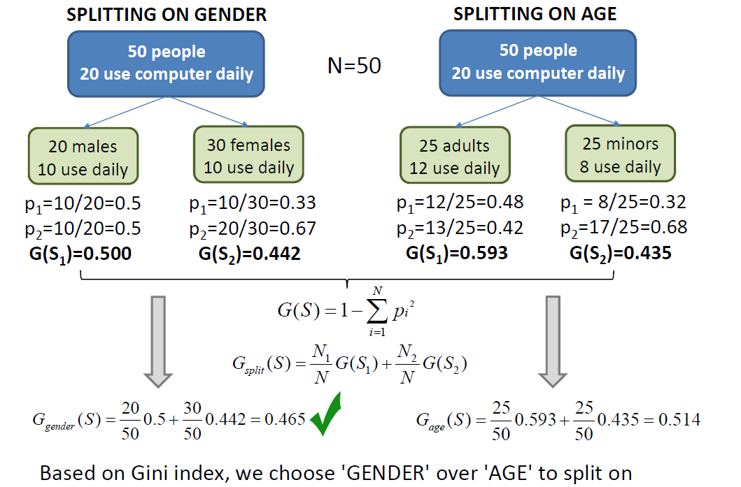
DECISION TREES
Example

Slide 14
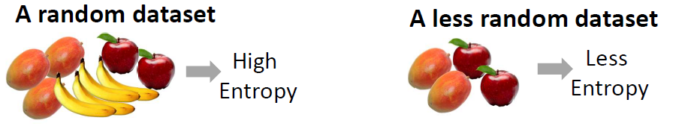
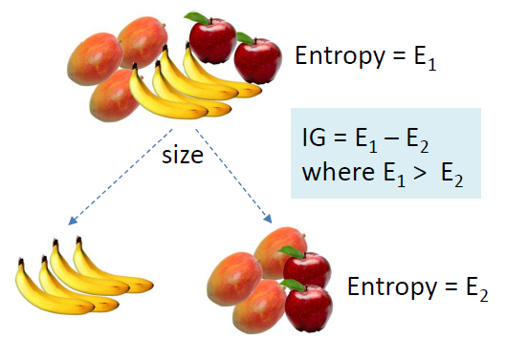
DECISION TREES
Information Gain
• "Information Gain" is a common splitting criterion and it’s based on a purity measure called “Entropy”
• Information Gain (IG):
Measure of decrease in
entropy after the split.
Constructing a decision
tree is all about finding
attribute that returns the
highest information gain
(i.e., the purist branches)

Slide 15

DECISION TREES
• How well each attribute splits a dataset into subsets with respect to a chosen target variable is measured by "purity".
• The most common splitting criterion is "Information Gain" based on a purity measure called "Entropy".
• Entropy is a probabilistic measure of uncertainty:
More uncertainty => More entropy (deviation from purity)
• When we have a set of possible events in a dataset S as p1, p2, ... ,pN, we compute the entropy "H" to assess the uncertainty of the outcome as:

Slide 16
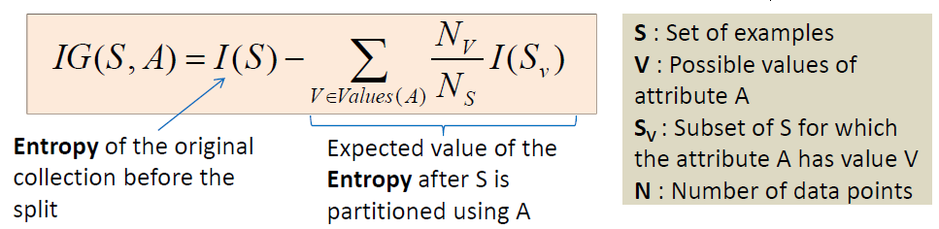

DECISION TREES
• Using a decision algorithm, we start at the tree root and split the data on the feature that results in the largest Information Gain (IG) defined as follows:
IG(attributeA) = info(parentNode) – info(childNodes)
• This tells us how much entropy of the training set we are reducing by selecting a particular feature/split
S, Sleft and Sright: Data set of the parent, left child node and right child node where Ni is the number of data points in each branch

Slide 17
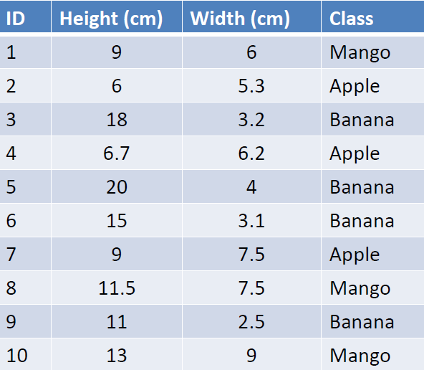
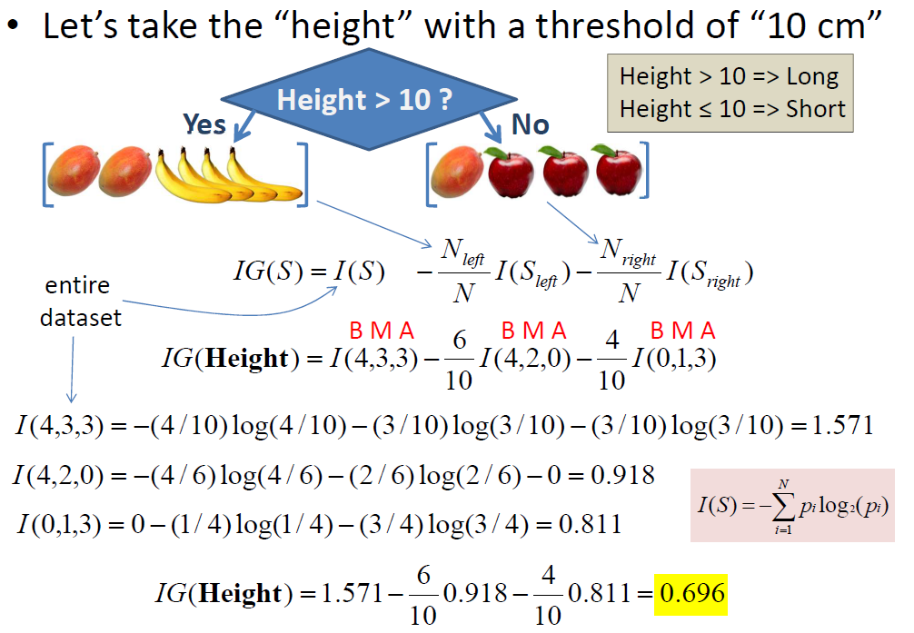

DECISION TREES
• Let’s create a DT for the example below:
– 2 features width, height
– 3 classes mango, apple, banana
Data

Slide 18
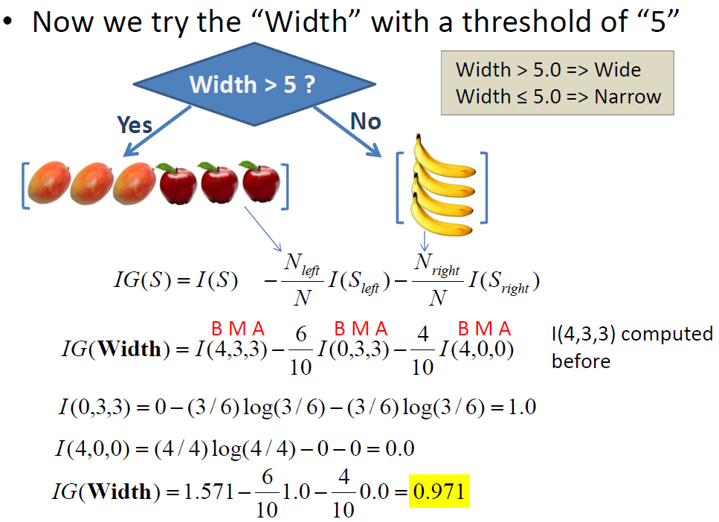
DECISION TREES

Slide 19
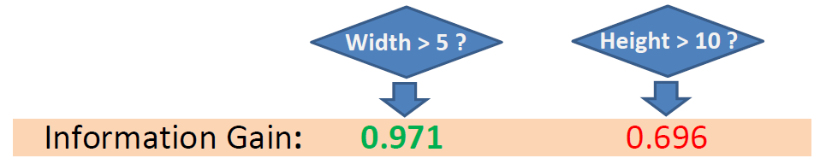
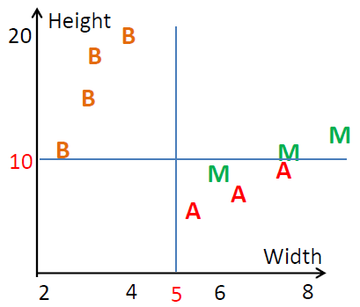
DECISION TREES
• Lower entropy => Higher gain
• Feature “Width of 5.0” creates a better gain
• Now we can proceed with the left branch of “Width > 5.0?” and split it further
• Question: How do we know that splitting with another threshold (for either feature) won’t yield a better solution (higher gain)?

Slide 20
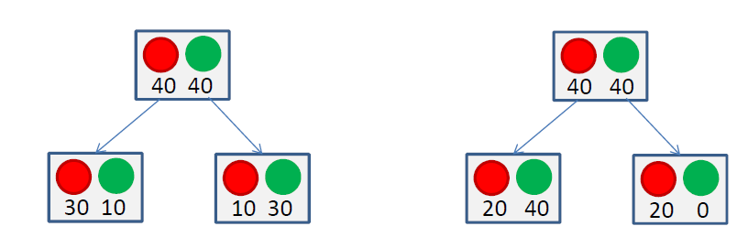
DECISION TREES
• Why not use the misclassification error, rather than the impurity, to determine the best way to split a node?
• A simple example below shows that choosing a split that minimizes the classification error doesn’t always lead to the best long-term growth of the tree.
• Both splits lead to a classification error of 20/80 = 25%. But the split on the right is better as it has a pure node (perfect classification) and it leads to better DT’s in the long run.
We therefore use impurity for the best split.

Slide 21
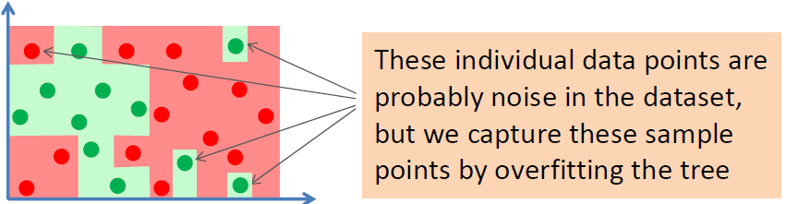
DECISION TREES
When do we stop growing the tree?
– your node contains only 1 class (perfect purity)
– node contains less than N data points
– max. depth is reached (number of splits allowed)
– node purity is sufficient
– you start to overfit
• Perfect classification on training examples is always possible for decision trees which leads to overfitting.
• Decision trees are very flexible. As the number of nodes increase, they can accommodate arbitrarily complex decision boundaries (zero training error) resulting in overfitting. This happens when you keep splitting the data until you get all singletons (all pure subsets).

Slide 22
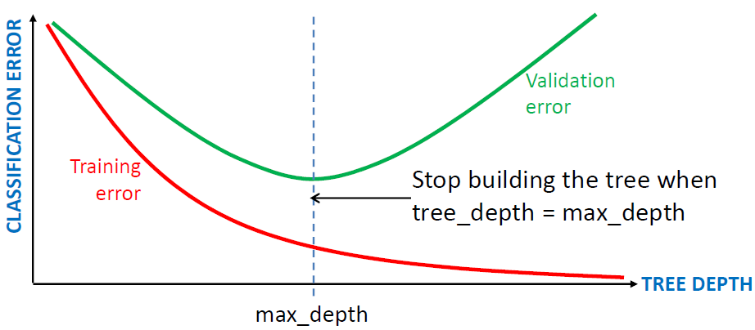
DECISION TREES
Prevent overfitting
• Stopping early : aka Pre-pruning the tree
1. Limit the Tree Depth
• We can use cross validation to detect the point where the validation error is minimum with respect to the model complexity
(max tree depth)
2. Use Statistical Significance
• Keep splitting until splitting further doesn’t improve the accuracy
Use a threshold ε :
Stop if the error does not improve more than, say 1% (ε=0.1)
• Limit the Number of Data Points in a Node:
Stop if the number of instances in a node becomes too small (when < Nmin=10 to 100 depending on the size of the data set)

Slide 23
DECISION TREES
• Pros
– Observable, easy to understand & interpret (white box)
– Compact (#nodes << D after pruning) and fast classification (O(depth))
– Requires little data preparation
– Able to handle both categorical & numerical data
– Fast, robust and computationally cheap
– Tolerance to irrelevant features
– Some tolerance to correlational inputs
– Performs well with large datasets (but generally poorly with many classes & small data – will yield interesting info even for small datasets)
– Ability to deal with noisy or incomplete (missing) data
– Outliers or linearly inseparable data are no problem
• Cons
– Greedy (may not find the best tree)
– Complex trees are hard to interpret
– Can create over-complex trees that don’t generalize well from the training data
(can easily overfit – low bias/high variance)
– Relatively less predictive in many cases (unbalanced data leads to biased trees)
– Cannot work on linear combinations of features
– Non-rectangular regions are not treated well

